Slide 1


Epicor-Sales Audit
IGATE is now a part of Capgemini

Slide 2




Agenda
Introduction
Sales Audit Data Flow
Translate process
Edit Process
Smart load Application.
Interfaces
Sales Audit Day End Flow
Day end & Period End
Database Flow (Table Groups)
Reports
Quiz

Slide 3
Introduction
In retail, the sales audit function describes the process of reviewing the Point-of-Sale (POS) transaction data for accuracy
Sales Audit process validates the totals from POS against the calculated totals of transactions. If these totals are not equal, you can report this variance as an over or short value.
It also manages foundation data, purchasing and cost, inventory, price, and financial processes.

Slide 4

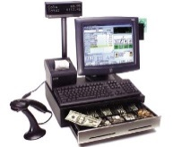


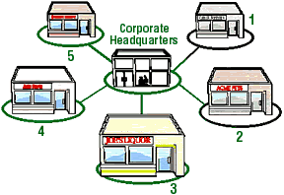


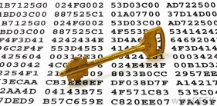
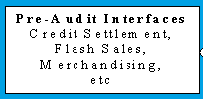

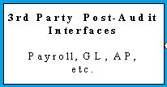
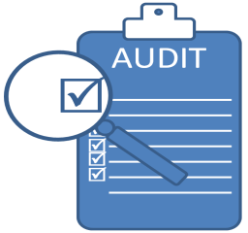
Sales Audit – Data Flow Overview
After the polling process the TSXML files will be moved to Sales audit server
Transactions in the stores
After the Transactions, the information of the transaction is stored in TSXML files
Sales audit App server
1st pass polling
Encryption Key Services
Translate & EDIT Processes
Pre-Audit
Using the FTP , the data will move into pre-audit interfaces l
Pre-auditors have to check before sending to audit
Post-Audit Interfaces
Day End
Sales audit Database
Now the sales are in SA DB for auditing
archives tax details
Creates post audit interface files
data ready for day-end
Auditors have to accept the Sales

Slide 5

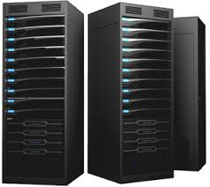
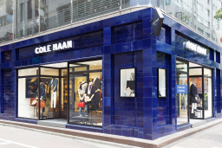
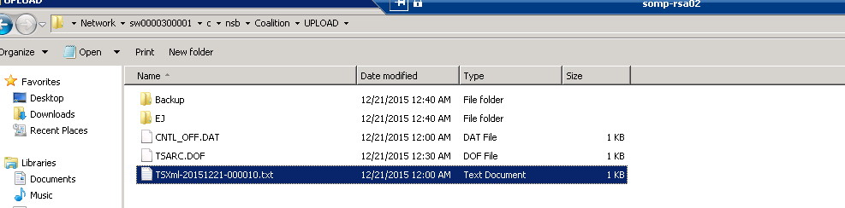
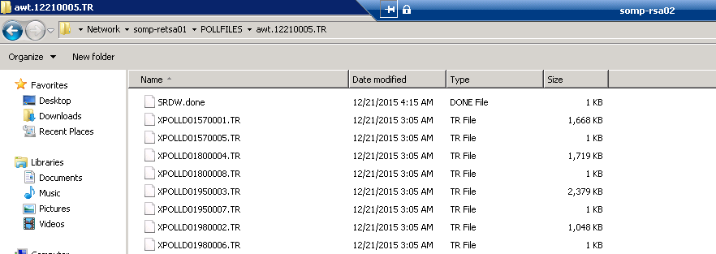
Sales Audit Data Flow - Polling
Upload data to head office
to Audit works Server
Information is collected from the registers
1st pass polling
Store 1
Polling is the process of pushing/pulling generally referred as I/O operations of data files from the machines inside the Cole Haan environment
1st polling -data is transfer from store to corporate
Store 2
Store 3
Sales Audit server
Stores
Data in Sales audit Server
Tsxml files in Stores

Slide 6
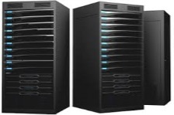
Work Flow Process
(Corporate Server)
{ Batch Process :
Connected Retail store
will process the job}
{ Scheduled task: will execute the batch jobs and push the files to corporate server}
From : somp-retsa01\D:\dataloadin\domestic\
To : somp-retsa01\D:\Retail_Apps\aw_xpr_colehaan\pollfiles\
Incase the batch job fail to move the file from store to corporate “ we need to move it manually”
Sales Audit server

Slide 7

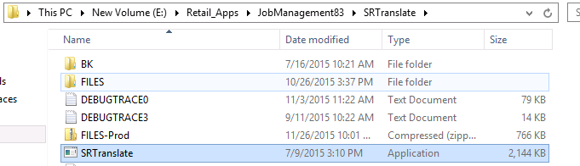
Translate Process
It is basically a data-mapping tool that converts data from the POS format(tsxml file) into a pre-defined format that is understood and used by the application.
The function of the Translate process is to accept data from any POS device and “translate” that data into a form that can be loaded into the Auditworks database.
Additionally, POS codes are translated into transaction line ”object-actions” that form the basis for the text descriptions that Users see when enquiring upon a transaction or viewing a report in Auditworks
EAI Server has Machine Prod (SRMainSA.exe) which is
In SOMP-RETSA01(sales audit application server)
Prod Machine has a Server called DWServer
DWServer has several jobs :
Translate – DW
Translate – AWT1
Directory Watcher (SRDW.exe) - loops every 1 minute
Translate (SRTranslate.exe) - spawned by SRDW

Slide 8









Translate – Flow overview
1
2
SRDW process
will be running
on the folder
awt.*.IP is created
XPOLLD* without extension(tsxml) files
4
5
6
7
SRDW process
Looks for awt.*.IP/
XPOLLD*
Creates
Converts the Polled files into .DW
XPOLLD* .DW
ICT_EDIT
Translate process
XPOLLD* .GO*
XPOLLD* .IP
Converts the .IP files Into .TR
3
9
awt.*.IP is now convertes into .TR
8
SRDW.done
awt.*.TR
XPOLLD* .TR

Slide 9
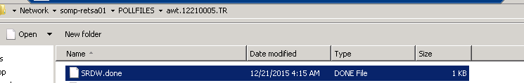
Translate Process
SRDW.exe (d:\Retail_Apps\Smartload\jobmaintainence\SRDW)
always running and looking for *.IP directories
Loops every 1 minute
Identifies if pollfiles need to be processed…
spawns the SRTranslate.exe process with “details” from the “Translate Setup Wizard”
Looks if there is a *.DONE file in the directory and concludes translate processing of the directory
Back to loop…

Slide 10
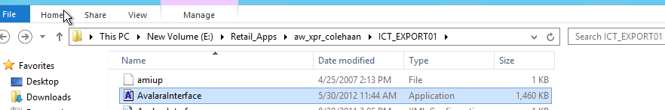
Translate Process
TranTypes.AWL ascii file
describes each individual store file
From CR in Services Admin
Exported via ICT_EXPORT smartload
BinTranTypes.AWL facilitate the translate (reading)
Store file | Store | Register | Reg-Type | Translate | Version | Company
0002???? | 2 | 1 | 1 | 200 |  | 20
0003???? | 3 | 1 | 1 | 200 |  | 20
0004???? | 4 | 1 | 1 | 200 |  | 20

Slide 11
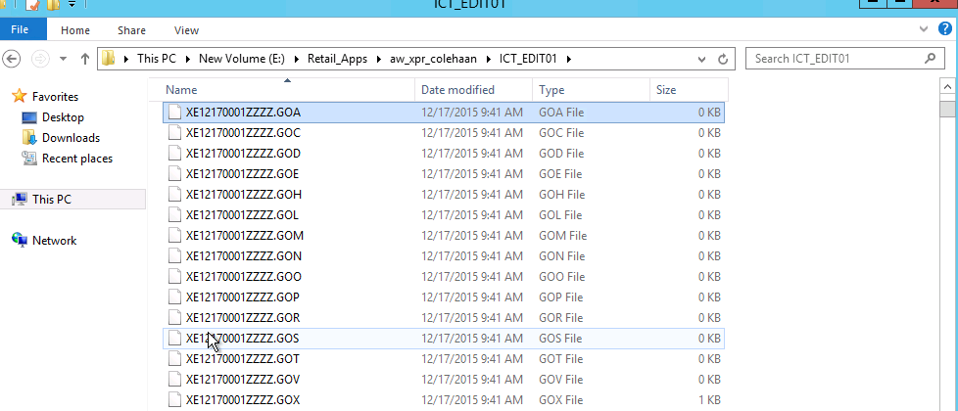
Translate Process
The 15 translated GO files per batch. These 15 files correspond to the standard data formats expected by Auditworks and represent the following record categories:
X*.GOA Authorisation detail records
X*.GOC Customer detail records
X*.GOD Discount detail records
X*.GOE Expanded customer detail records
X*.GOH Transaction header records
X*.GOL Transaction line records
X*.GOM Merchandise records
X*.GON Line notes records
X*.GOO Special order detail records
X*.GOP Payroll detail records
X*.GOR Return detail records
X*.GOS Stock control detail records
X*.GOT Tax Override records
X*.GOV Post void detail records
X*.GOX Translate error records

Slide 12
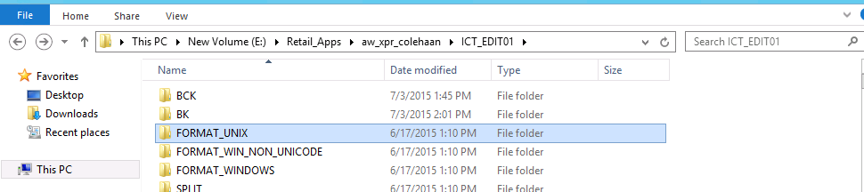
Translate Process
Once the *.IP sales file is completed it’s renamed to *.TR
Upon max batch size (2000) the files are cpio’ed into one file and sent to the ICT_EDIT as FTPXddddttttssss
Parameters for the sizing of batches and destination ICT_EDIT dir is installed at setup

Slide 13
Translate – Flow Review
awt.*.IP is created
XPOLLD* without extension(tsxml) files
Process will be running
on the folder
Looks for awt.*.IP/
XPOLLD*
Creates
Converts the Polled files into .DW
SRDW process
XPOLLD* .DW
ICT_EDIT
Translate process
XPOLLD* .GO*
XPOLLD* .IP
Converts the .IP files Into .TR
SRDW.done
awt.*.IP is now convertes into .TR
awt.*.TR
XPOLLD* .TR

Slide 14

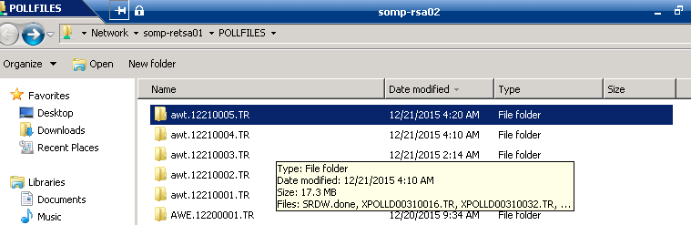
Translate- Folders

Slide 15




Sales Audit Data Flow - Edit
Store 1
1St
Store 2
Translate process
Store 3
Stores
Edit process(Edited)
- Further validations are performed on the translated data
- Populates the current Sales Audit Tables and can be viewed by user
- Records audit concerns found in Guided Audit tab
- All records (invalid and valid records) found in Audit Status

Slide 16
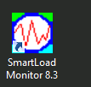
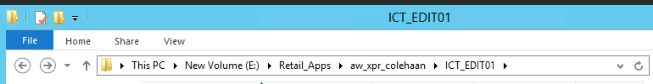
Edit Process
The function of the Edit process is to perform various validation checks on the data received from the Translate and populate the Audit works database with the data, calculate a number of derived totals and initiate any pre-audit interfaces that may be defined.
Assign statuses (Invalid Store / Invalid Register /Invalid Date/ Missing / Edited)
Location: d:\Retail_Apps\aw_xpr_colehaan\ICT_EDIT
Can be bounced by SmartloadMonitor and is a SMARTLOAD process
Always running on the system looking for work

Slide 17
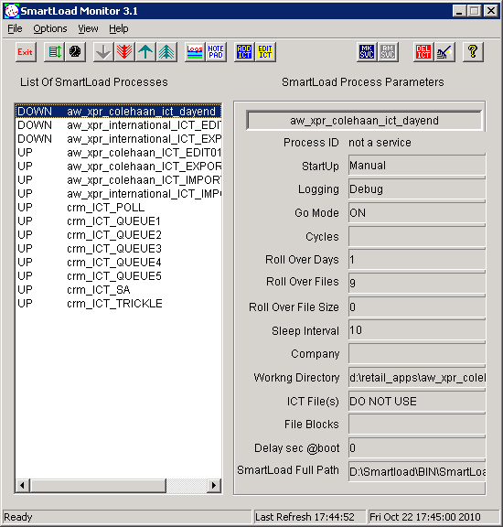
Edit Process - Smartload
SmartLoad is a data manipulation utility that handles the transfer of data between NSB applications and other systems.
Smartloads were written by Epicor in ‘C’ language
Once started, a SmartLoad process will continuously search for and manipulate data files that are ready to be processed.
The SmartLoad process has the ability to:
- Transfer files between systems, using ftp
Setup, delete, initialize, query, and manipulate specified tables
- BCP files in/out of an Sales Audit database
- Execute shell scripts of any complexity to test and manipulate files
- Handle a wide variety of error conditions
- Maintain a log file of all operations
- Execute cleanup operations

Slide 18
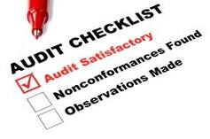
Sales Audit Data Flow - Interfaces
Store 1
1st pass polling
Translate process
Store 2
Store 3
Stores
Pre-Audit
Edit process(Edited)
- Pre-Audit Interface posting from Sales Audit to host systems
- No S/A rejects will be included
- I/F rejects will not update specific interfaces
Ex: Credit Settlement, Flash Sales, Merchandising, Customer Liability

Slide 19

Interfaces
Interfaces to other systems are implemented using SmartLoad ICT files or by Foundation Exports.
The interfaces are initiated either by the Edit process (Pre-Audit) or Day End (Post-Audit).
From these, ASCII files may be produced and made available to other applications.
Your data is now in Sales Audit and ready to be audited!!

Slide 20

Sales Audit Data Flow - Audit
Store 1
1st pass polling
Translate process
Store 2
Audit Verified
Store 3
Stores
Pre-Audit
Edit process(Edited)
- Sales Transactions are audited and verified in the Guided Audit screen
- Once fixed, Transactions are then fed to the Pre-Audit Interfaces

Slide 21

Sales Audit Data Flow - Accept
Store 1
Store 1
1st pass polling
Translate process
Store 2
Store 2
Store 3
Store 3
Stores
Pre-Audit
Edit process(Edited)
Audit Verified
- All auditing concerns have been handled
- Data is accepted, ready to archive and ready to dayend
Accept

Slide 22
Sales Audit Data Flow - Accept
TRANSLATE
AUDIT “Verified”
Polling
EDIT
Accept
Pre-Audit
Stores
- All auditing concerns have been handled
- Data is accepted, ready to archive and ready to dayend

Slide 23





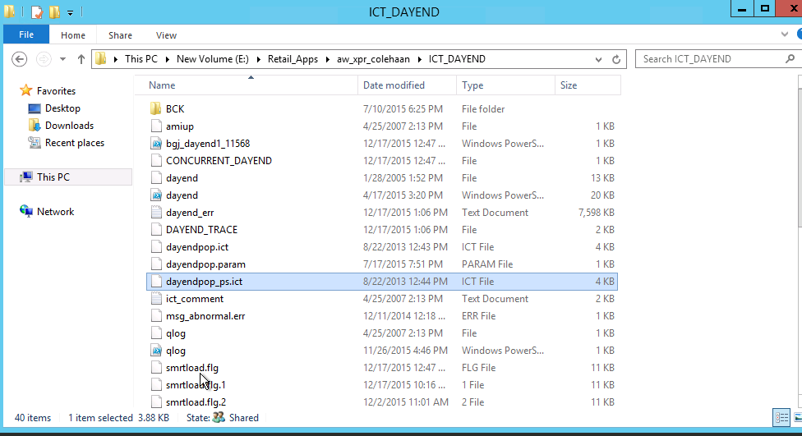
Sales Audit Data Flow - DayEnd
1st pass polling
Post-Audit
Store 1
Translate process
Store 2
Dayend “Completed”
Store 3
Stores
Edit process(Edited)
Pre-Audit
Accept
Audit Verified
- Accepted records get a status of Completed
- Updates post-audit interfaces internal and external (Subledger, Tax, CRM)
- Puts data from current tables to archive tables (no more modifications)

Slide 24
Sales Audit Data Flow - DayEnd
TRANSLATE
AUDIT “Verified”
Polling
Accept
EDIT
Dayend “Completed”
Pre-Audit
Stores
Post-Audit
- Accepted records get a status of Completed
- Updates post-audit interfaces internal and external (Subledger, Tax, CRM)
- Puts data from current tables to archive tables (no more modifications)

Slide 25
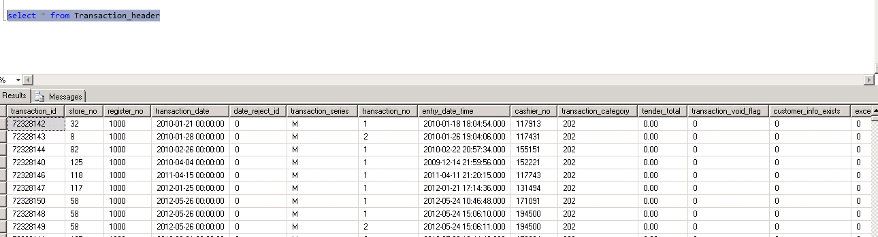
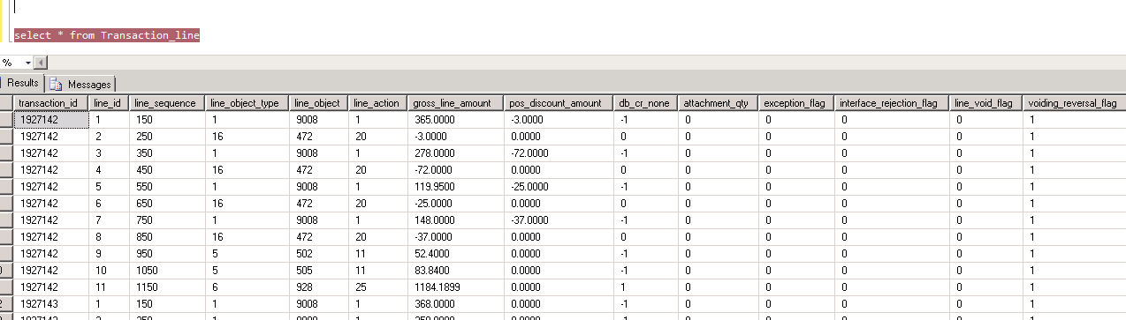
Database Flow - Table Groups
Auditworks has its 2 main data tables for viewing (linking) information.
Transaction_header / Transaction_line on aw_xpr_xxxx Database for colehaan
Transaction_header contains columns such as :
transaction_id transaction_no
store_no tender_total
register_no cashier_no
transaction_date entry_date_time
Transaction_line contains columns such as :
transaction_id line_object_type
line_id line_object
gross_line_amount line_action
Transaction_id is the same number in each table. It is used to link the 2 tables together (unique key)

Slide 26
Database Flow - Table Groups
Understanding those 2 tables we now have 3 categories of these tables which represent the 3 states of a store/register/date in Auditworks.
Current tables (transaction_header, transaction_line)
Interface tables (if_transaction_header, if_transaction_line)
Archived tables (av_transaction_header, av_transaction_line)
Current tables are for ‘Edited’ transactions.
The life of a store/register/date will go through all these tables. Information cannot be in current and archive at the same time.
Interface table information is exactly what it says. Interface tables are a copy of the information that is being sent to the interfaces .

Slide 27
Database Flow - Table Groups
Tables are used for sales Audit process:
1st Level of staging
2nd Level of staging
3rd Level of staging
IF(Interface):
IF_Transaction_Header (All Info)
IF_Transaction_Line (In Detail of transaction)
Transaction:
Transaction_Header
Transaction_Line
CH(Colehaan):
Ch_Transaction_Header
Ch_Transaction_Line
Vision DB:
1_NSB_Transfers (Ref: ch_Transfers_vw)
Sales_Audit (Ref: Ch_Transfers_vw)
SA_Load_Control (Ref: RTV & Transfers)
Merch.iri_pos_transfers (Ref: Style_Id)
NSB_poll_Replishment (Ref: Polling the data for vision and run the jobs)
{Same Information passed to Vision DB after sales audit process}

Slide 28
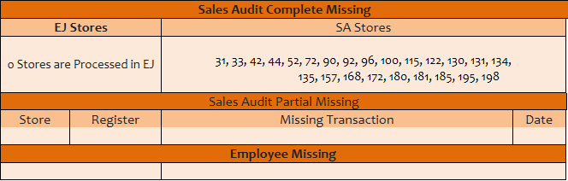
Sales Audit Reports
We will monitor the processing of the sales into sales into the sales audit server and sales audit database.
For that we will send a reports thrice a day internally and final will send it to the pre-auditors to verify from their end. Below is the simple report format that we send .

Slide 29
Quiz
1. What is Sales Audit?
A)Processes and validates all sales transactions from all channels, ensuring clean and consistent sales information
B)Process carried out on a certain number of retail outlets to measure the effectiveness, sales trends, sales volume etc. of a brand or product in the retail outlet.
C)A sales audit is a review of a company's entire sales process, from the use of particular types of software, to the staff, to management strategies
D) All the above(Ans)
2. What type of organizations use auditing services?
A) Non-for-profit organizations
B) Businesses
C) Governments
D) All of the above(Ans)
3. The audit risk model is used primarily
A) while doing tests of controls.
B) to determine the type of opinion to express.
C) for planning purposes in determining how much evidence to accumulate.(Ans)
D) to evaluate the evidence which has been gathered.

Slide 30


